Slide 1
Texas Tech University Health Sciences Center
Purchasing quarterly meeting
Ttuhsc pURCHASING

Slide 2
Agenda
Year End Guidelines
Coca Cola Contract
Copier Contracts
User Groups
How to register
Original Documents sent to Purchasing/Accounts Payable
Purchasing email
Sciquest.com emails
Correct email: purchasing@ttuhsc.edu
Questions and Answer period

Slide 3
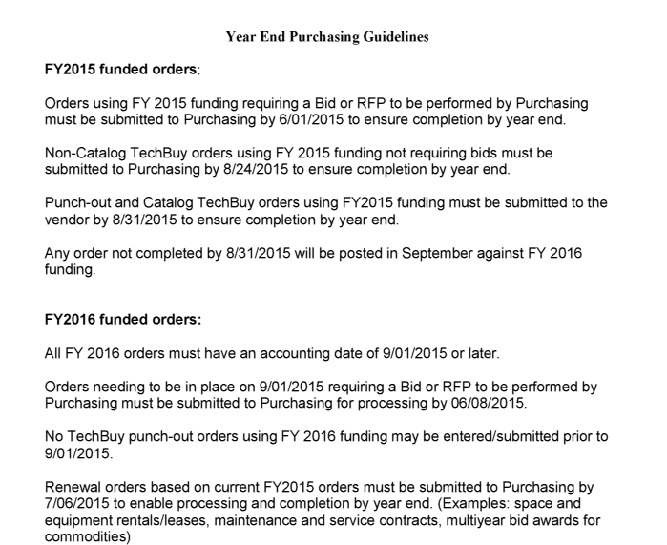
Year End Guidelines

Slide 4
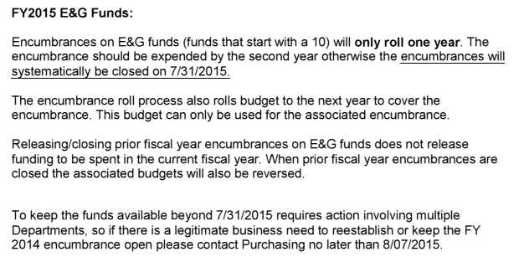
Year End Guidelines cont.
Link to Year End Guidelines:
http://www.fiscal.ttuhsc.edu/purchasing/collateral/Year%20End%20Purchasing%20Guidelines.pdf

Slide 5
Coca Cola Contract
Guidelines for Complying with TTUS Coca-Cola Sponsorship Agreement
Texas Tech University System (TTUS) has an exclusive Sponsorship Agreement with Coca-Cola Refreshments USA. TTUS has agreed no competitive products (non-Coke products) will be sold, distributed, sampled (distributed at no cost), advertised or promoted at any time on any TTUS, TTUHSC, TTU or ASU campus. Included in the agreement are individual/single serve bottles of water.
The agreement allows for students, faculty, staff and visitors to bring up to 5 cases of competitive (non-Coke) products on campus for personal consumption. The agreement does not allow for TTUS to purchase nor reimburse students, faculty staff or visitors for non-coke products.
In an order to comply with the Sponsorship Agreement TTUHSC will not purchase via PO, P-Card or Direct Pay any non-Coke branded products for sale, distribution, or sampling on any TTUHSC campus.
Sample of allowable Coca-Cola water products:
PowerAde®
DASANI®
Glaceau® smartwater
Glaceau® vitaminwater
Glaceau®

Slide 6
Copier Contracts
The State contract for copier rentals will expire 8/31/2015 and will not be renewed. If you have not been contacted by the Xerox representative regarding the rental contract, please be advised this contract will expire August 31, 2015. Customers are required to issue a 30-day cancellation notice prior to August 31, 2015, requesting removal of the unit. Purchasing can assist you in issuing a cancellation notice to the vendor, closing the order and establishing a new copier with a new vendor if needed.
For assistance please contact Sylvia Bradley 806-743-7390 or Sylvia.Bradley@ttuhsc.edu

Slide 7
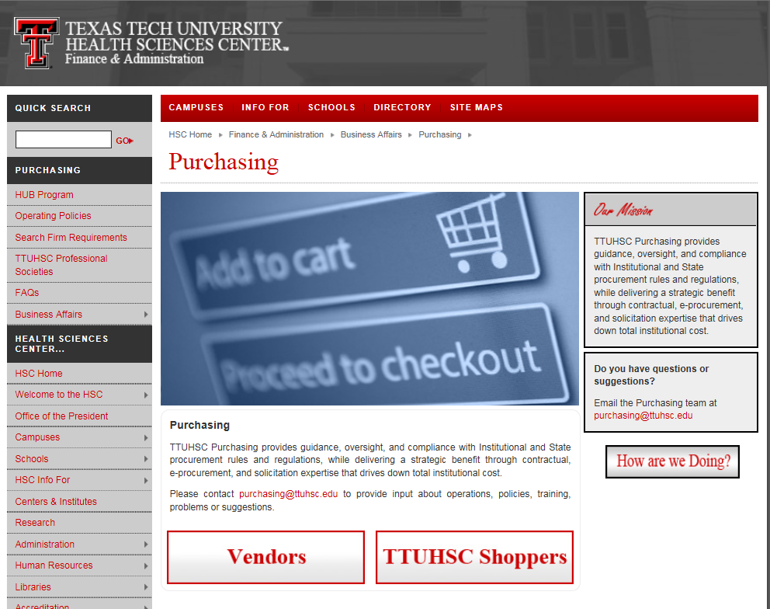
User Groups
User Groups are set up to send out announcements to the users who have joined. From the Purchasing website select Business Affairs. Next, select Finanace Management Systems.
Select Business Affairs,
then Finance Management Systems

Slide 8
Next, select User Groups.
Select User Groups

Slide 9
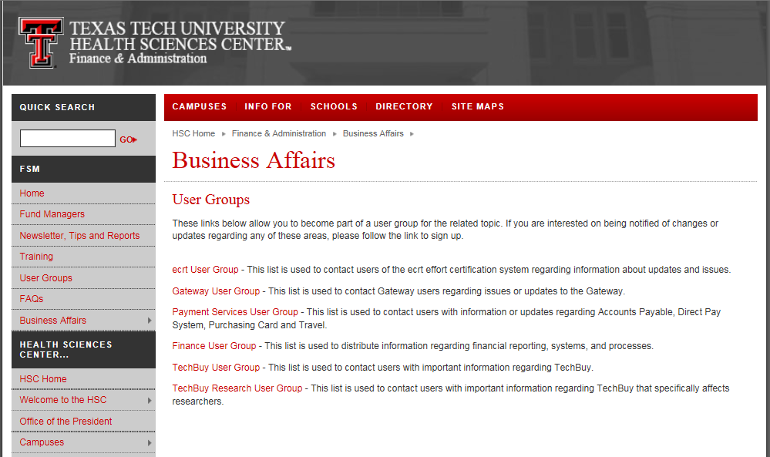
Next, select User Groups that you would like to receive announcements on.
Select Group(s)

Slide 10
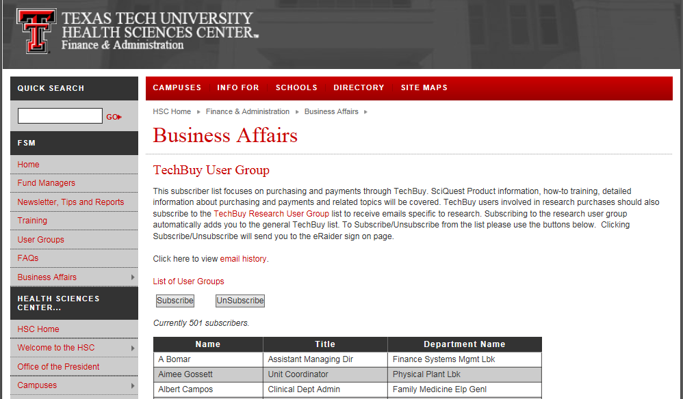
Next, select Subscribe or Unsubscribe.
Select Subcribe

Slide 11
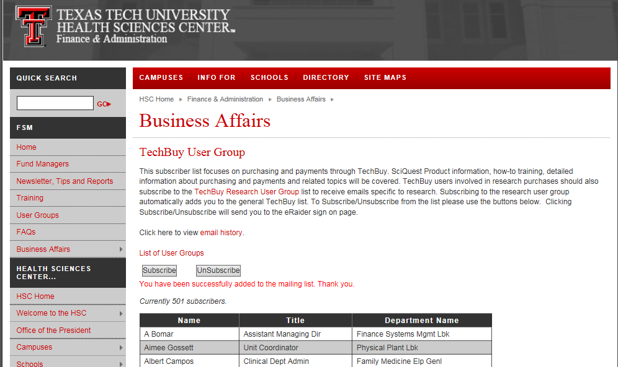
Once Subscribe is selected the system will notify you have been successfully added to the mailing list.

Slide 12
Original Documents sent to Purchasing/Accounts Payable
Please make sure to include the PO number on all documentation sent to Purchasing and Accounts Payable. If the PO number is not included it is difficult to match the proper PO and documentation together.

Slide 13
Purchasing Contact Information
System Generated emails – DO NOT hit reply to system generated emails (emails that come from SciQuest). Sciquest emails are monitored by TTU staff and only one HSC staff member. Please create a new email or forward email to Purchasing@ttuhsc.edu
Please make sure to use the correct Purchasing inbox email address: Purchasing@ttuhsc.edu

Slide 14
El Paso Purchasing Contacts
Purchasingelp@ttuhsc.edu
Annette A. Hinojos
Annette.A.Hinojos@ttuhsc.edu
915-215-4582
Juan Frias
Juan.Frias@ttuhsc.edu
915-215-4554
Efisio Setzu
Gerardo.Efisio.Setzu@ttuhsc.edu
915-215-4927
Mary Vasquez
Mary.C.Vasquez@ttuhsc.edu
915-215-5070

Slide 15
Questions ?

